Slide 1

𝐸𝑥𝑝𝑙𝑜𝑟𝑎𝑡𝑜𝑟𝑦 𝐷𝑎𝑡𝑎 𝐴𝑛𝑎𝑙𝑦𝑠𝑖𝑠
𝐴𝑠𝑝𝑖𝑟𝑖𝑛𝑔 𝑀𝑖𝑛𝑑 𝐸𝑚𝑝𝑙𝑜𝑦𝑚𝑒𝑛𝑡 𝑂𝑢𝑡𝑐𝑜𝑚𝑒 2015 (𝐴𝑀𝐸𝑂)

Slide 2
Data Description And Objective
The dataset provided by Aspiring Minds from the Aspiring Mind Employment Outcome 2015 (AMEO) focuses on employment outcomes of engineering graduates, specifically
The primary objective of this study is to analyse the employment outcomes of engineering graduates. This includes understanding factors influencing salary, job titles, and job locations. The dataset provides standardized scores from three different areas: cognitive skills, technical skills, and personality skills, along with demographic features.
Through data exploration, data Analysis and statistical analysis, this dataset can help in understanding the dynamics of engineering employment and inform strategies for career development and recruitment in the engineering sector.

Slide 3
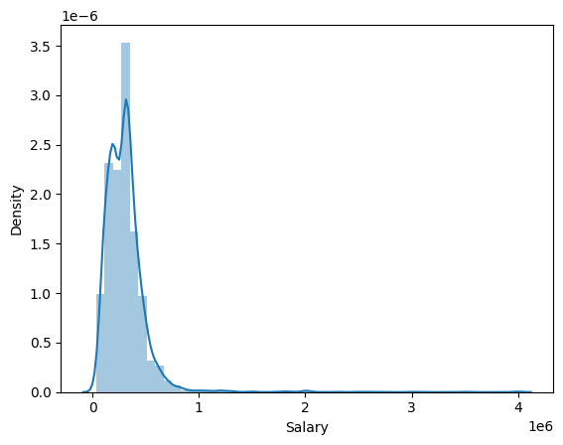
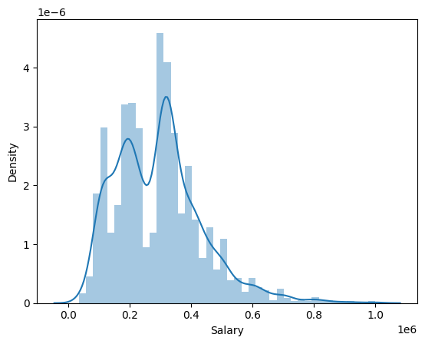
Data Analysis(Univariant & bivariant)
From the KDE plot, it is apparent that the distribution of salaries does not follow a normal distribution; instead, it displays a pronounced right-skewed tail, indicating the possible existence of outliers within the salary data.
To enhance the dataset's quality, we conducted outlier detection by isolating entries where the salary surpassed $1,000,000. Following this identification process, these outliers were systematically eliminated from the dataset, ensuring a more accurate representation of the data for analysis.

Slide 4
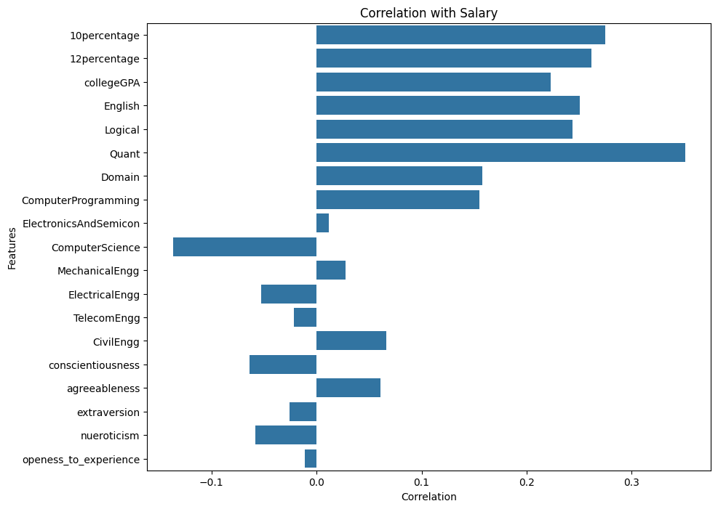
Correlation With Salary
Academic Performance: There is a moderate positive correlation between 10th and 12th percentage scores and salary. This suggests that individuals with higher academic scores tend to command higher salaries.
Technical Skills: The correlation between technical skills such as Quantitative Aptitude (Quant) and Computer Programming with salary is moderately positive. This implies that individuals with stronger quantitative and programming abilities tend to earn higher salaries
Personality Traits: Interestingly, there are weak correlations, both positive and negative, between certain personality traits (conscientiousness, agreeableness, extraversion, neuroticism, and openness to experience) and salary. These correlations suggest that while personality traits may play a role in job performance and career advancement, their impact on salary is relatively minor compared to other factors like academic and technical skills.

Slide 5
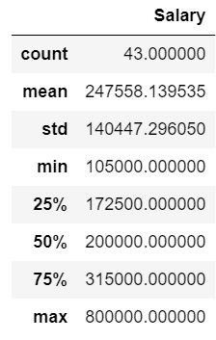
Research Questions
Times of India article dated Jan 18, 2019 states that “After doing your Computer Science Engineering if you take up jobs as a Programming Analyst, Software Engineer, Hardware Engineer and Associate Engineer you can earn up to 2.5-3 lakhs as a fresh graduate. Test this claim with the data given to you.
Based on the provided data, we observe that fresh graduates with a background in computer engineering, entering roles such as Programming Analyst, Software Engineer, Hardware Engineer, and Associate Engineer, command an average salary of ₹2,47,558.
The salary difference between the highest and average salaries in this group is ₹5,52,441.

Slide 6
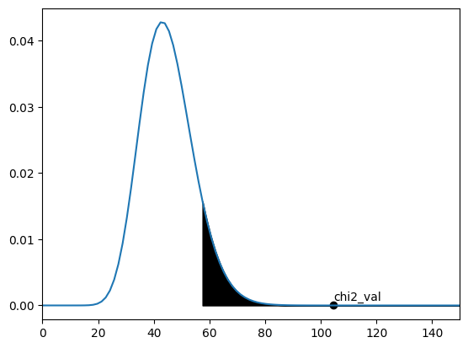
Is there a relationship between gender and specialization? (i.e. Does the preference of Specialization depend on the Gender?)
To address the question of whether a relationship exists between gender and specialization,
H0: There is no relationship between gender and specialization; gender and specialization preference are independent variables.
H1: There is a relationship between gender and specialization; gender and specialization preference are dependent variables.
Furthermore, employing a confidence level of 90% and an alpha value of 10%, the chi-square value remains within the critical range. This suggests sufficient evidence to reject the null hypothesis in favor of the alternative hypothesis, indicating a statistically significant relationship between gender and specialization.

Slide 7

THANK YOU

